Slide 1
Project Title: U.S. Airline Performance & Delay Analysis ✈️📊
Subtitle: Business Analysis Report
Submitted by- Synsharlang Wahlang
Submitted- Synsharlang Wahlang

Slide 2
Introduction The U.S. airline industry connects millions of passengers annually, but flight delays and cancellations remain a major challenge, affecting operations and customer satisfaction. This project analyzes historical U.S. domestic flight data to: 1) Identify patterns and causes of delays and cancellations. 2) Evaluate airline and airport performance (OTP%, average delays, cancellation rates). 3) Provide actionable insights to improve efficiency and passenger experience.

Slide 3
Problem Statement Content: 1) Flight delays and cancellations affect passengers, airlines, and airports. 2) Airlines want to know the causes of delays to improve OTP. 3) Airports want to optimize operations and reduce bottlenecks.

Slide 4
Project Objectives 1) Analyze causes of flight delays and cancellations. 2) Benchmark airline and airport performance using OTP%, delay, and cancellation rates. 3) Identify trends by month, day, time, and route. 4) Provide actionable recommendations to stakeholders.

Slide 5
Methodology
Collected historical U.S. domestic flight data (airlines, airports, flights: delays, cancellations).
Cleaned and prepared data: removed duplicates, handled missing values, categorized delays by cause.
Analyzed data using SQL to calculate OTP%, average delays, and cancellations.
Built interactive dashboards in Power BI/Tableau to visualize trends and KPIs.
Derived actionable insights for airlines, airports, and regulators.

Slide 6
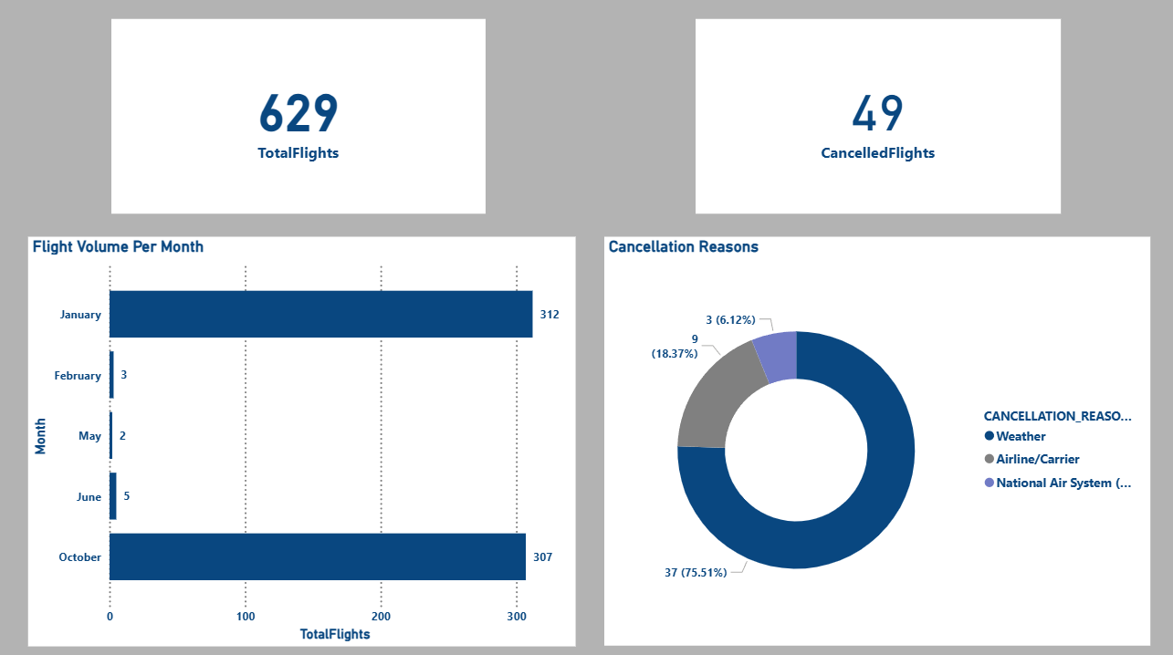
Overview Delays/Cancellations.

Slide 7
Why It Happened?
Flight peaks in January & October due to holiday/seasonal travel.
Weather was the main cause of cancellations (75%) → winter storms, fog.
Airline/Carrier issues (18%) → staff shortage, technical & scheduling problems.
Air System delays (6%) → air traffic congestion & ATC restrictions.
What’s Next?
Strengthen weather preparedness (forecasting tools, backup plans).
Improve airline operations (staffing, aircraft maintenance, scheduling).
Work closely with Air Traffic Control to manage congestion.
Spread flights more evenly across months to reduce operational pressure.
Enhance passenger communication for better customer experience.

Slide 8
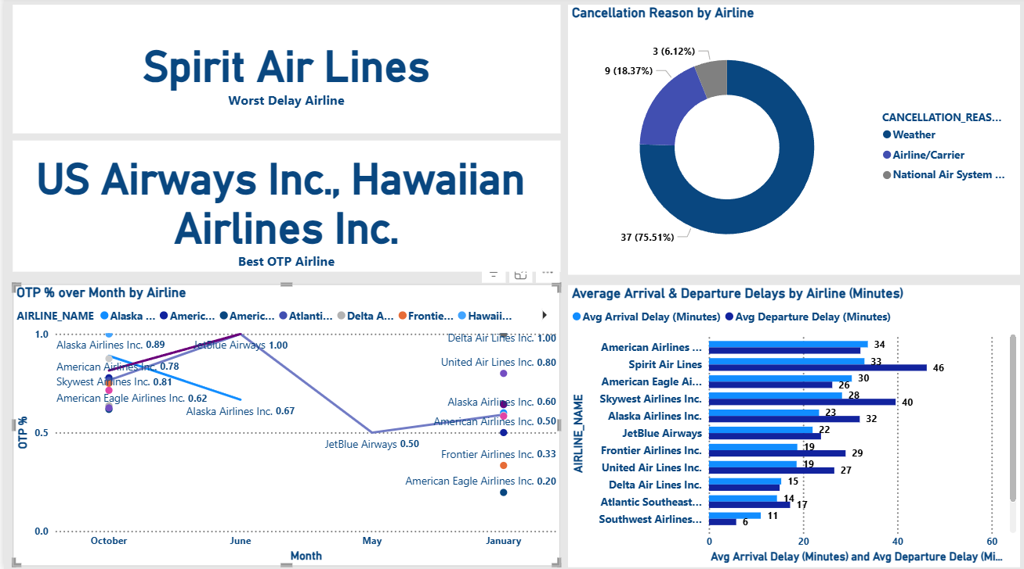
Airline Performance

Slide 9
Why It Happened?
Worst Delay Airline: Spirit Airlines → highest average departure delay (46 mins).
Best On-Time Performance (OTP%): US Airways Inc. & Hawaiian Airlines Inc.
Weather was the leading cause of cancellations (75%), followed by carrier issues (18%).
JetBlue Airways showed lowest OTP (0.50), while Delta Airlines achieved near perfect OTP (1.00).
Average delays varied widely:
High delays: Spirit, American Eagle, Skywest.
Low delays: Delta, Southwest, Alaska.

Slide 10
What’s Next?
Focus on Delay Reduction: Airlines like Spirit, JetBlue, and American Eagle must improve turnaround processes and scheduling.
Learn from Best Performers: Replicate practices from Delta, Hawaiian, and US Airways to boost OTP.
Weather Readiness: Stronger investment in weather monitoring and proactive re-routing.
Operational Improvements: Better crew planning, maintenance scheduling, and ground handling.
Customer Experience: Communicate delays transparently and provide support to retain trust.

Slide 11
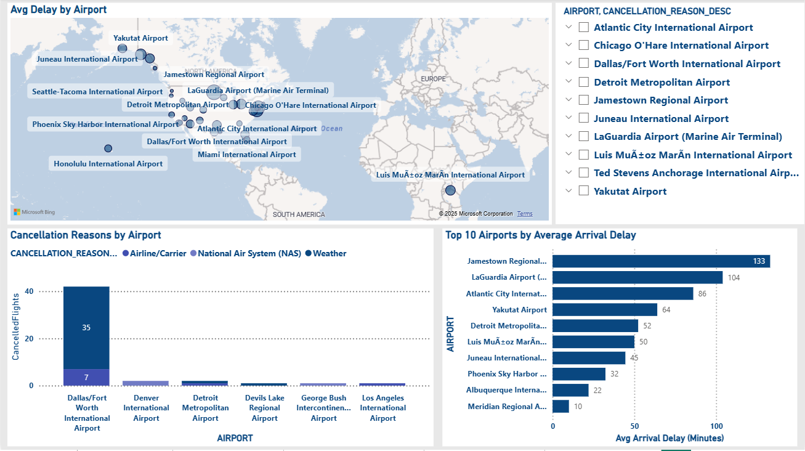
Airport Performance

Slide 12
Why It Happened?
1.Airline/Carrier Failures: Most cancellations at DFW (35 of 42) are due to internal airline issues.
2.Extreme Localized Delays: Jamestown Regional shows an unusually high average arrival delay of 133 minutes.
3.Top Cancellation Airport: Dallas/Fort Worth has the highest number of flight cancellations.
4.Concentrated Delay Problem: Jamestown, LaGuardia, and Atlantic City account for the worst average arrival delays (85+ mins).
5.Weather is Minor: Only 7 cancellations at DFW were due to weather; most are airline-related.
What Next?
Target Carrier Operations: Airlines must resolve internal operational, staffing, and maintenance issues driving cancellations.
2.Investigate Jamestown: Identify and fix root causes of the 133-minute average arrival delay.
3.Delay Mitigation Strategy: Implement measures at Jamestown, LaGuardia, and Atlantic City to bring delays below 80 minutes.
4.Contingency Planning: DFW should collaborate with carriers to reduce passenger impact from airline-caused cancellations.
5.Monitor Performance Metrics: Track cancellations and average arrival delays at top airports to ensure corrective actions are effective.

Slide 13
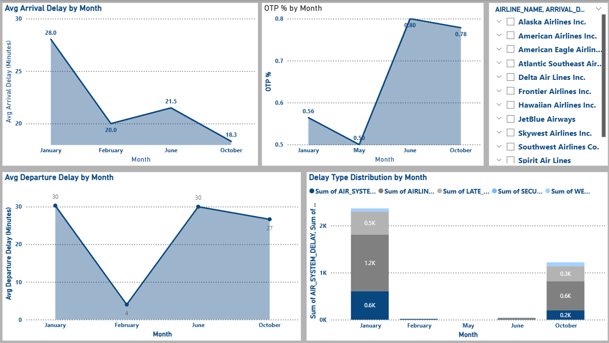
Temporal Trends

Slide 14
Why It Happened?
January – Winter Peak: High delays (Departure: 30 min) from airline and air system issues during post-holiday congestion.
2.May – Spring Scheduling Fragility: Lowest OTP (0.50) due to tight schedules failing under rising travel demand.
3.June – Summer Traffic Strain: Departure delays peaked at 30 min as high summer traffic overloaded the system.
4.February – Off-Peak Efficiency: Lowest departure delay (4 min) as reduced demand minimized congestion.
5.October – Favorable Fall Conditions: Highest OTP (0.78) and lowest arrival delay (18.3 min) with smooth operations and stable weather.
What Next?
Investigate January & June: Identify operational or external factors causing peak delays.
2.Target May's OTP: Analyze frequent minor delays or cancellations impacting on-time performance.
3.Reduce Airline Delays: Improve maintenance, staffing, and crew scheduling during peak months.
4.System/Infrastructure Review: Mitigate Air System and Late Aircraft Delays through operational improvements.
5.Adopt October's Model: Replicate staffing, scheduling, and operational practices from October for better performance.

Slide 15
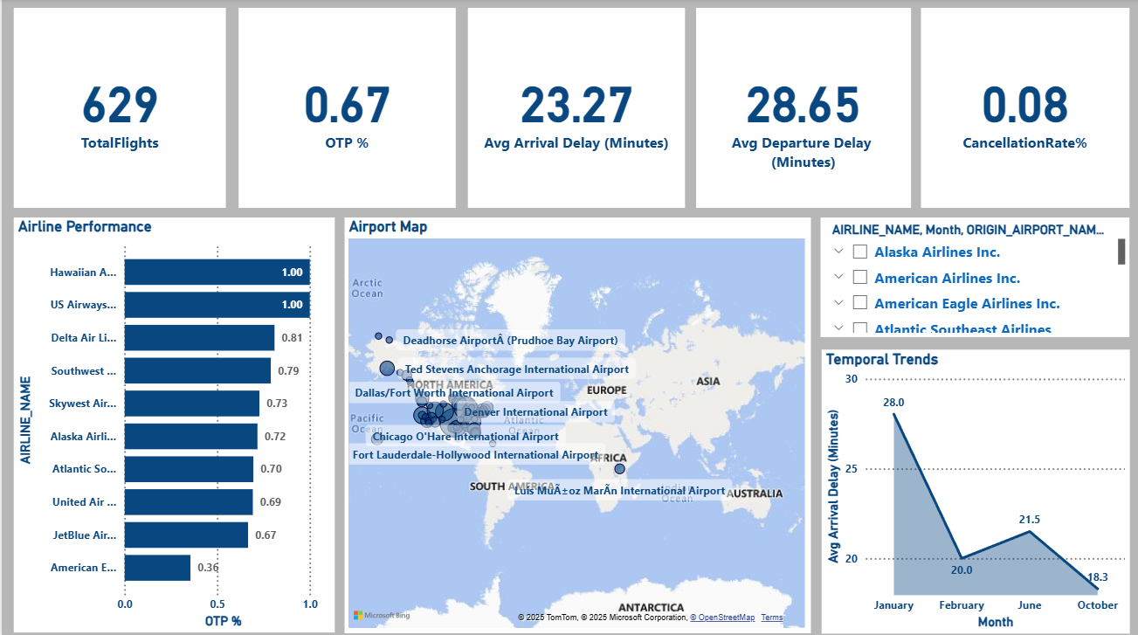
Overall Dashboard

Slide 16
What the Dashboard Shows:
Tracks OTP%, delays, cancellations by airline, airport, and month.
Highlights top and low-performing carriers and airports.
Shows temporal trends and causes of delays/cancellations.
Why It Matters:
Low OTP (0.67) and high departure delays (28.7 min) indicate systemic challenges.
Single carrier drag (American Eagle OTP 0.36) affects overall performance.
Seasonal peaks require proactive planning.

Slide 17
How Stakeholders Can Use It:
Airlines: Identify causes, benchmark, optimize operations.
Airports: Manage congestion, reduce cancellations.
Regulators: Track systemic issues and guide interventions.
Passengers: Plan travel based on reliability.
Next Steps:
American Eagle audit to address poor OTP.
2.Optimize ground operations to reduce departure delays.
3.Replicate best practices from top carriers.
4.Adjust staffing and schedules for peak months.
5.Improve OTP of mid-range carriers (0.67–0.79) for systemic impact.

Slide 18
Overall Recommendations – U.S. Airline Performance & Delays
Optimize Airline Operations: Improve turnaround, crew scheduling, and maintenance; adopt best practices from top performers.
2.Enhance Airport Efficiency: Target high-delay airports with smart ground operations and reduce bottlenecks.
3.Predict & Plan Proactively: Forecast peak delays, allocate resources, and integrate weather contingency plans.
4.Leverage Dashboards & Data: Use live dashboards and predictive analytics to identify and prevent delays.
5.Improve Passenger Experience: Communicate delays proactively and provide transparent support.
6.Strengthen Collaboration: Coordinate airlines, airports, and ATC to manage congestion and reduce system-wide delays.

Slide 19
Conclusion – U.S. Airline Performance & Delays
Flight delays and cancellations impact passengers, airlines, and airports.
Main causes: weather, airline operations, air system congestion, and seasonal peaks.
Wide variation in airline and airport performance; specific bottlenecks identified.
High-risk months: January & June; best performance: October.
Dashboard insights enable stakeholders to monitor, predict, and improve flight reliability.
Operational improvements, predictive planning, and collaboration can enhance efficiency and passenger experience.

